Slide 1
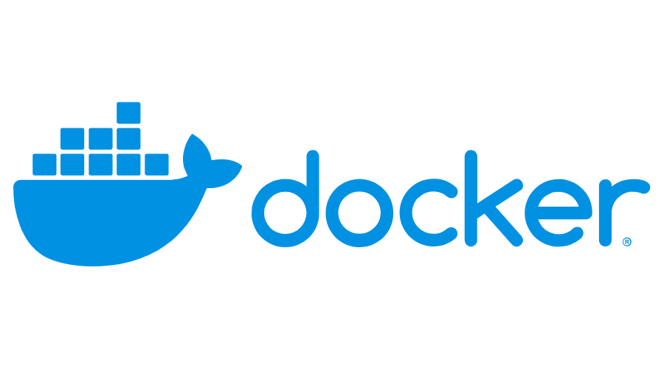
Domain 1 – Installation and Configuration
Created by :Gowtham
670390

Slide 2
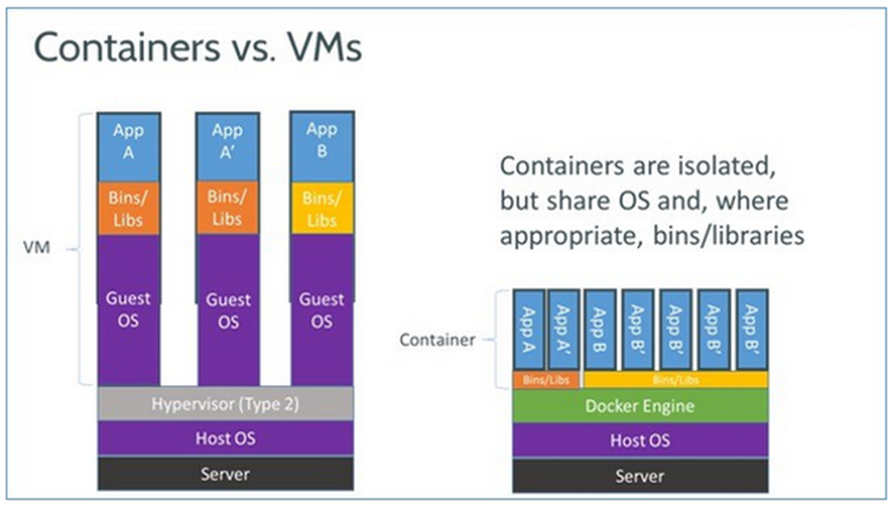
Containers vs Virtual Machines
A container runs natively on Linux and shares the kernel of the host machine with other containers. It runs a discrete process, taking no more memory than any other executable, making it lightweight.
By contrast, a virtual machine (VM) runs a full-blown “guest” operating system with virtual access to host resources through a hypervisor. In general, VMs provide an environment with more resources than most applications need.

Slide 3
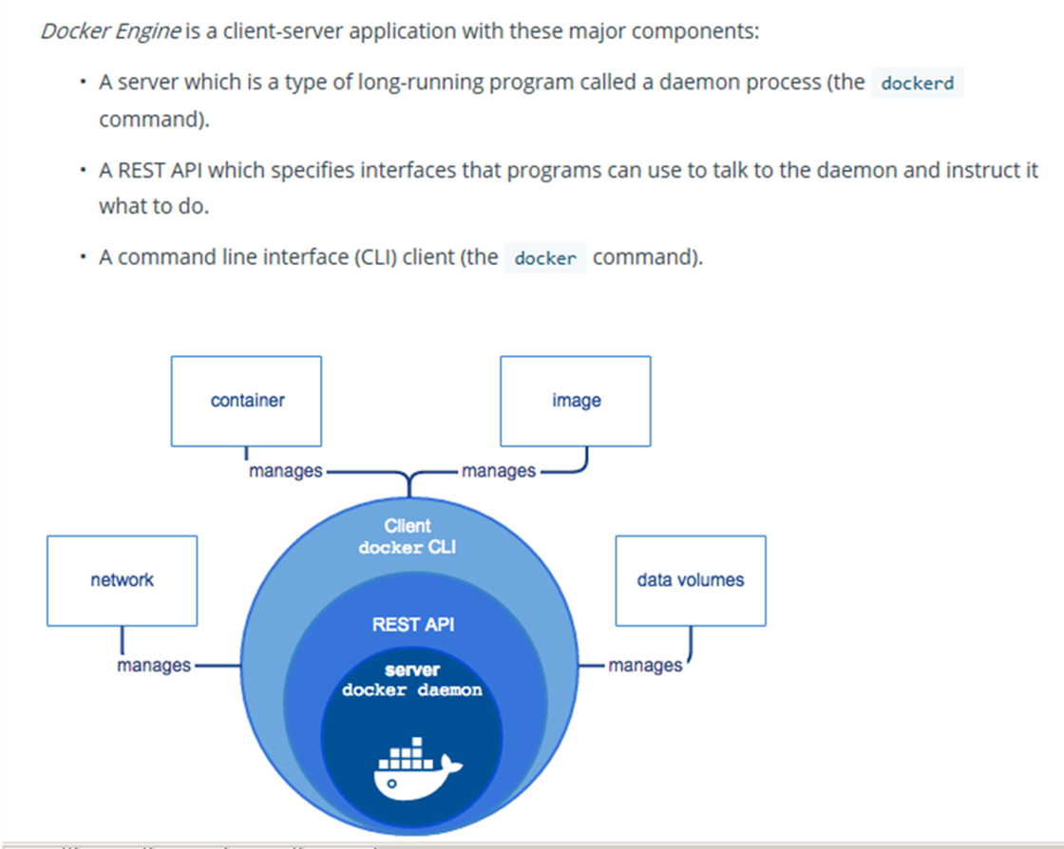
Docker Engine

Slide 4
Advantages of Docker Container
• They start and stop much faster than virtual machines.
• They are more portable because container host environments are very consistent, no matter which type of operating system is hosting them.
• Containerized applications are easy to scale because containers can be added or subtracted quickly from an environment.
• Containers make it easy to break complex monolithic applications into smaller, modular microservices

Slide 5
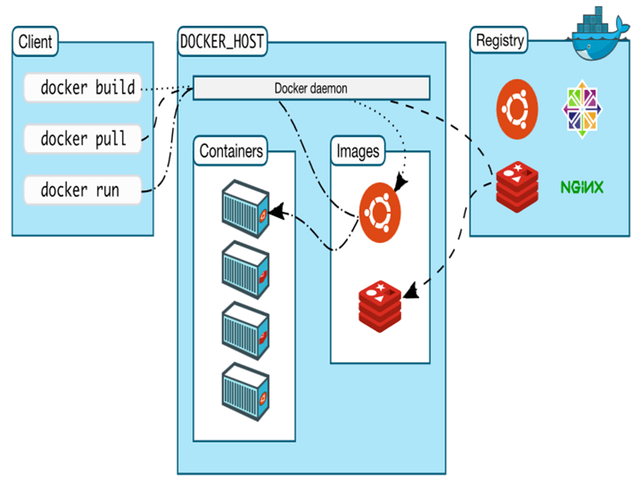
Docker Architecture

Slide 6
Namespaces
Docker Engine uses namespaces to provide isolation such as the following on Linux:
• The pid namespace: Process isolation (PID: Process ID).
• The net namespace: Managing network interfaces (NET: Networking).
• The ipc namespace: Managing access to IPC resources (IPC: InterProcess Communication).
• The mnt namespace: Managing filesystem mount points (MNT: Mount).
• The uts namespace: Isolating kernel and version identifiers. (UTS: Unix Timesharing System).

Slide 7
Control Groups
• Docker Engine on Linux also relies on another technology called control groups (cgroups). A cgroup limits an application to a specific set of resources. Control groups allow Docker Engine to share available hardware resources to containers and optionally enforce limits and constraints.
Common Cgroups:
CPU
Memory
Network Bandwidth
Disk
Priority

Slide 8
Union File System
• Union file systems, or UnionFS, are file systems that operate by creating layers, making them very lightweight and fast. Docker Engine uses UnionFS to provide the building blocks for containers.
Docker Engine can use multiple UnionFS variants like:
AUFS
Btrfs
Vfs
DeviceMapper

Slide 9
Container Format (default:libcontainer)
Container Format
Namespaces
UnionFS
CGroups

Slide 10
Get Docker CE for CentOS
There are two ways to install and upgrade Docker Community Edition (Docker EE) on Centos:
• YUM repository: Set up a Docker repository and install Docker EE from it. This is the recommended approach because installation and upgrades are managed with YUM and easier to do.
• RPM package: Download the RPM package, install it manually, and manage upgrades manually. This is useful when installing Docker EE on air-gapped systems with no access to the internet.

Slide 11
Steps to install Docker CE for CentOS
Uninstall older versions –
yum remove docker-ce
Install required packages –
yum install -y yum-utils device-mapper-persistent-data lvm2
Setting up a stable repository –
yum-config-manager --add-repo https://download.docker.com/linux/centos/docker-ce.repo
Install Docker CE - yum install docker-ce
Start Docker Daemon – systemctl start docker
Verify installation – docker --version

Slide 12
Dockerfile
Dockerfile – is a simple textfile with instructions on how to build your images
The FROM statement starts out by creating a layer from the ubuntu:15.04 image
COPY command adds some files from your Docker client’s current directory.
The RUN command builds your application using the make command.
CMD command in the last layer specifies what command to run within the container.

Slide 13
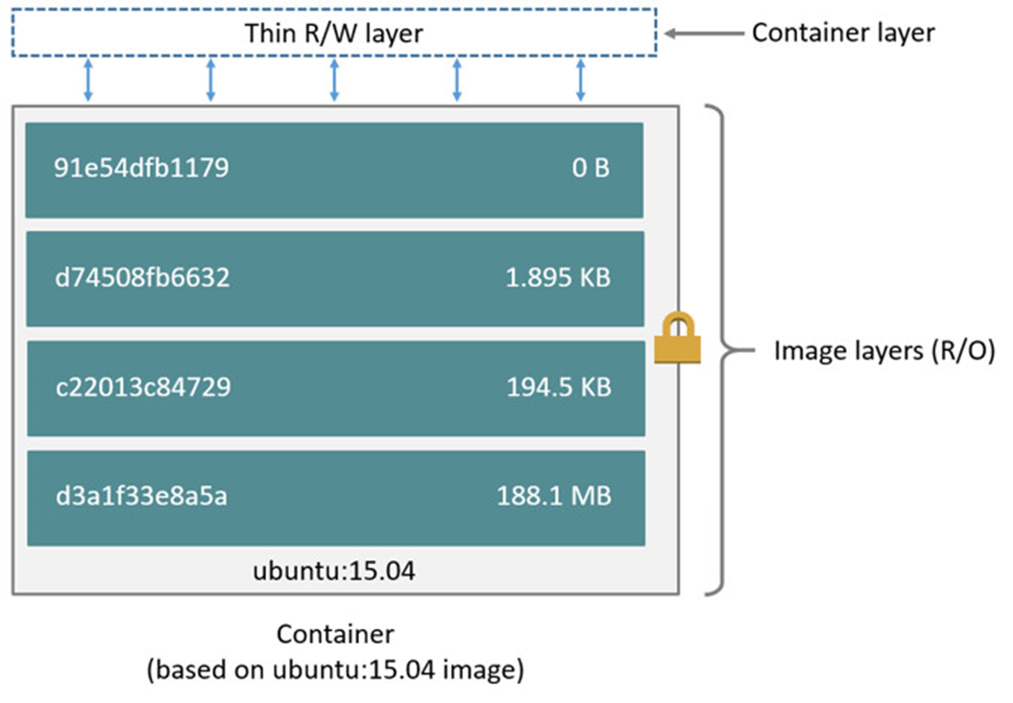
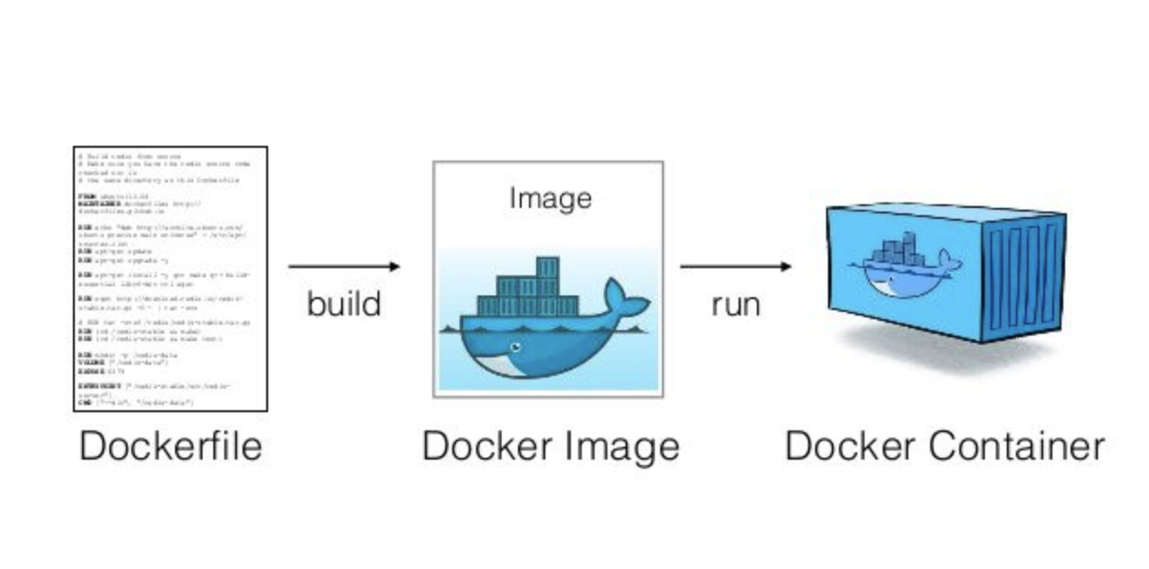
Docker Images
Images are read-only template from which Docker containers are launched.
Each image consists of a series of layers.
Docker makes use of union file systems to combine these layers into a single image.
Union file systems allow files and directories of separate file systems, to be transparently overlaid, forming a single coherent file system.

Slide 14
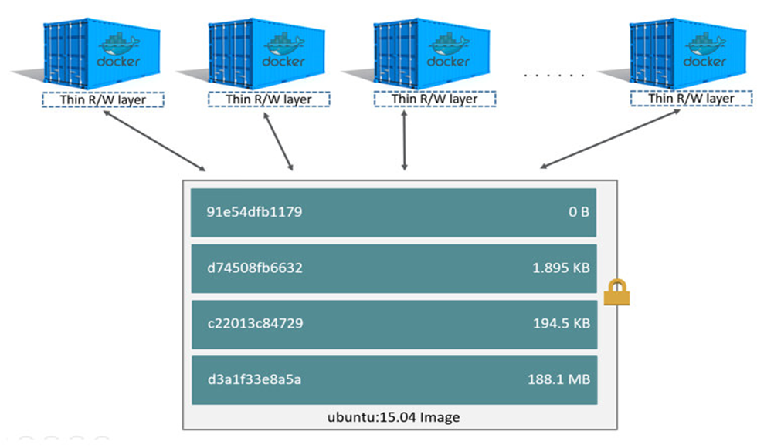
Docker Containers
Major difference between a container and an image is the top writable layer
All writes to the container that add new or modify existing data are stored in this writable layer
When the container is deleted, the writable layer is also deleted. The underlying image remains unchanged.
Each container has its own writable container layer, and all changes are stored in this container layer, multiple containers can share access to the same underlying image

Slide 15
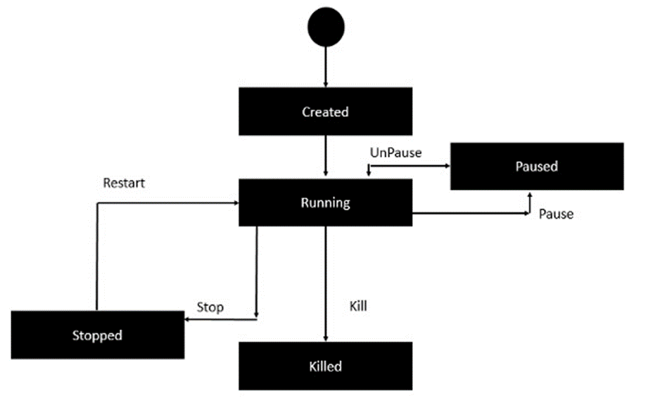
Docker - Container Lifecycle

Slide 16
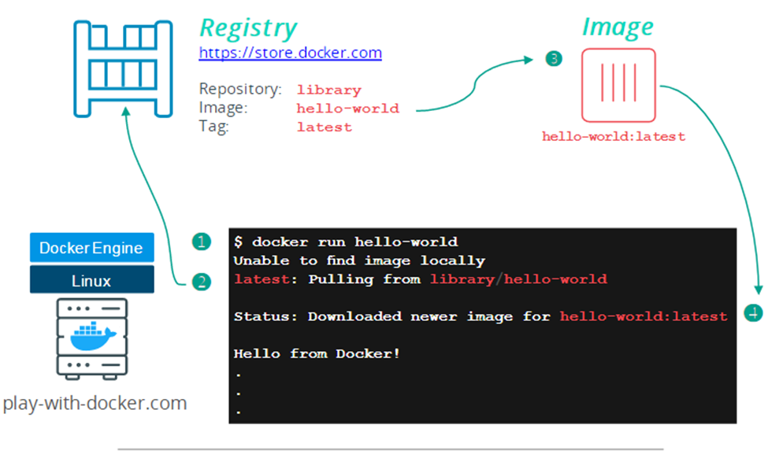
Docker Hands-On
docker version
docker info
docker run hello-world
docker image ls
docker ps
docker ps –a

Slide 17
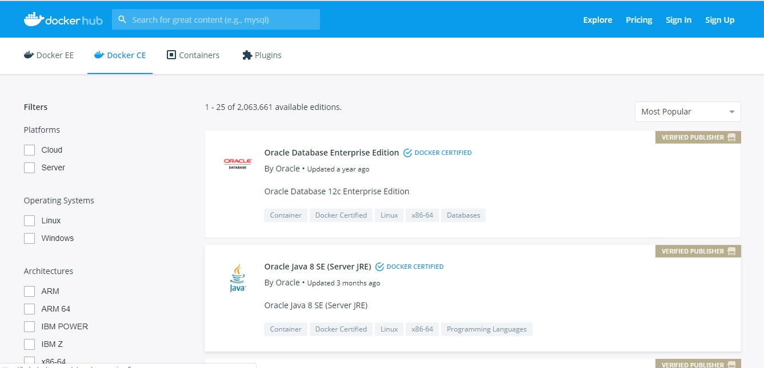
Dockerhub – Build and Ship any Application Anywhere

Slide 18
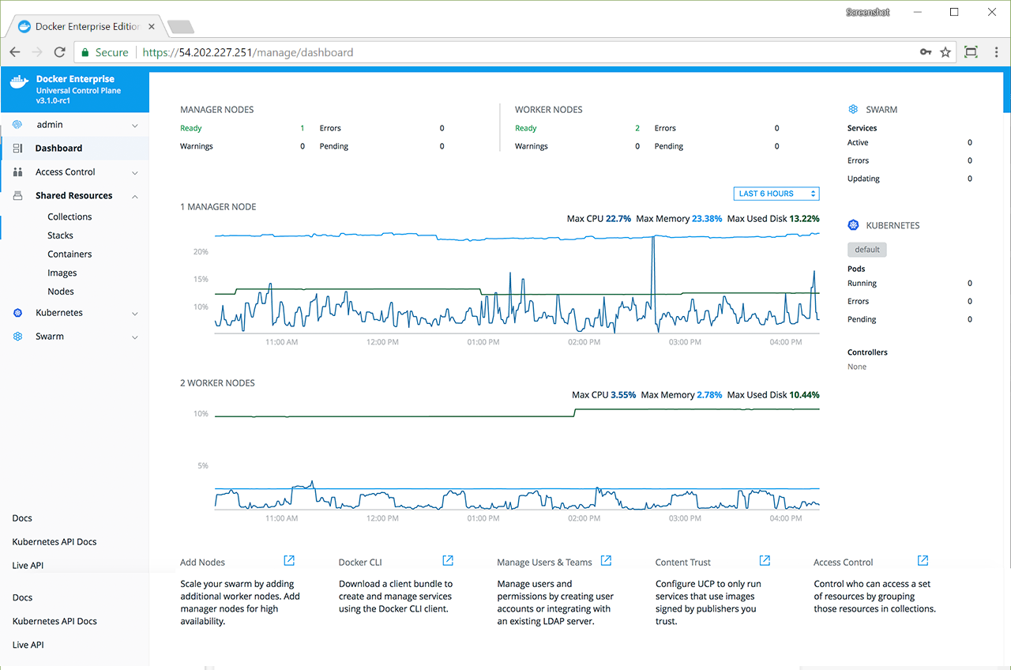
UCP and DTR
Docker Trusted Registry (DTR) is the enterprise-grade image storage solution from Docker. You install it behind your firewall so that you can securely store and manage the Docker images you use in your applications.
Docker Universal Control Plane (UCP) is the enterprise-grade cluster management solution from Docker. You install it on-premises or in your virtual private cloud, and it helps you manage your Docker cluster and applications through a single interface.

Slide 19
References
play-with-docker.com
docs.docker.com
https://github.com/DevOps-Academy-Org/dca-prep-guide

Slide 20
